Slide 1
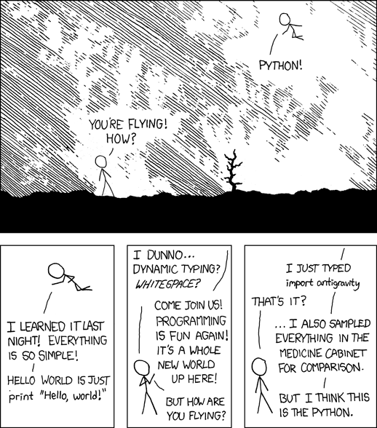
The Coding Toolbox.
Week 1 | Lecture 2 (1.2)
Upcoming:
Lab 1 released Wednesday AM
Reflection 1 released Thursday at 11 AM
Practical/Lab section – Friday 1-4 PM
Notes:
Historical figures, history of computer
Extensions, terminal, cPU, RAM, GPU, memory, transistors
Maybe visualise how all the departments disciplines are involved
Tools in course:
Anaconda
Jupyter
Environments
Shortcuts on Jupyter (shift enter) markdown etc.
Cells are linked, variables common across cells
Update cells down doesn’t update cells above
Kernel restarting
Clear output and variables

Slide 2
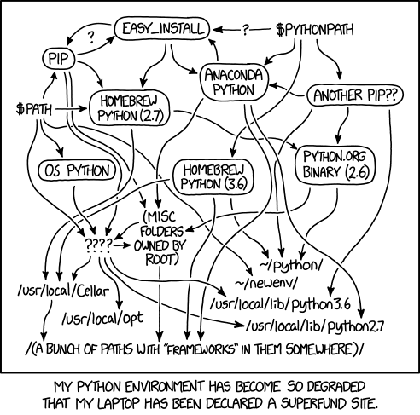
This Week’s Content
Lecture 1.1
Introduction
The Coding Toolbox
Lecture 1.2
Variables, Operators, and Expressions
Functions, Input and Output
Lecture 1.3
Custom Functions
Design Problem: Forward Kinematics (Robotics)

Slide 3
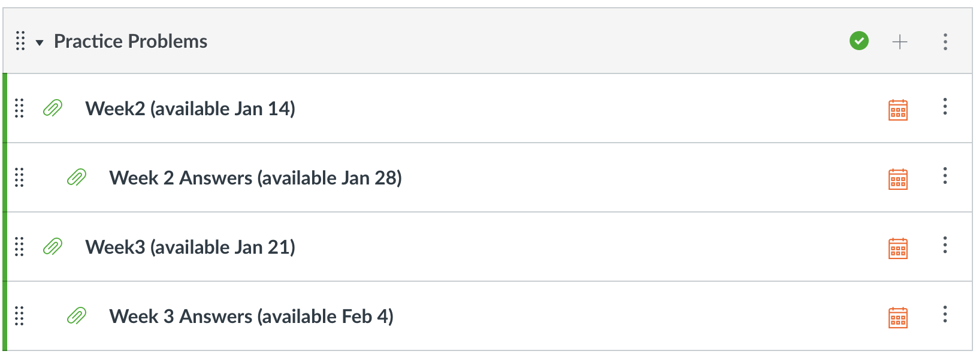
Reminder for Success: Practice!
Programming is a language
Everything is cumulative
Practice Problems released weekly, with solutions released 1 week later
Use labs and practice problem sets as litmus tests
Do them all, take note of which questions give you trouble

Slide 4
Overview of Coding trajectory across different disciplines?

Slide 5
What you will get out of today’s lecture:
Everything you need to begin coding in APS106
Learn about the core building blocks of a computer
Develop computational language and vocabulary for the files and programs used in APS106
Learn about the key differences in the software and tools used in APS106
Get experience opening and using the most important tools
Execute your first files of APS106!

Slide 6

What do you need to code?
A Computer
Input/Output devices
Storage
Memory
Processor
An Integrated Development Environment (IDE)
VSCode
Jupyter vs JupyterHub
Installing with Anaconda
A Programming Language
Why we use languages
Compiling from high level to low level languages
A File with appropriate format
File formats and extensions
Python programming files (.py vs .ipynb)
Notes:
Goes into more detail in next slides

Slide 7

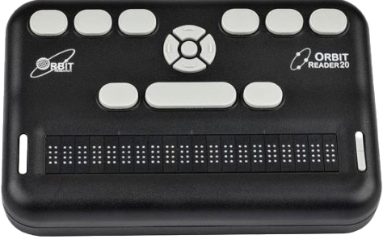
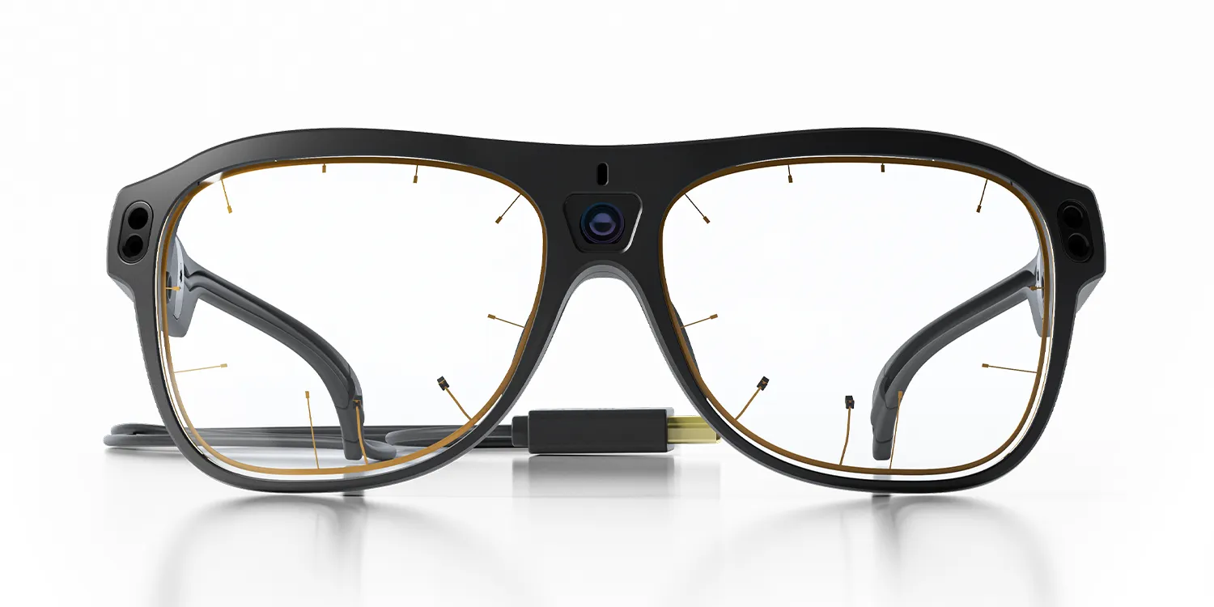
Outside Your Computer
Input Devices
Keyboard
Mouse
Trackpad
Touch screen
Webcam
Gesture trackers
Eye trackers
Output Devices
Monitors
Printers
Headphones
Speakers
Video/sound cards
Braille readers
Eye Tracking Glasses
Braille Reader

Slide 8
Inside Your Computer
Storage
Disks, hard drives, thumb drives, etc.
Stores long-term data (files, programs, movies, etc.)
Non-volatile: maintains contents when powered off
Memory
Random Access Memory (RAM)
Stores short-term data required for open programs and processes
Volatile: loses contents when powered off
Software programs are usually stored and executed from RAM.
Later this term, we will learn how to read from and write to long-term storage.

Slide 9
Inside Your Computer
Central Processing Unit (CPU)
Runs the programs, including the operating system
Reads and writes the data between storage and memory
Composed of billions of miniature electronic switches called transistors
Popular examples include Intel’s Core i7 and AMD’s Ryzen 7
Clock
Controls the rate processors execute instructions (recall: programming is just a series of instructions)
Modern computers have clocks that beat around 4 GHz (4 billion times per second!)
World records for number of transistors on a chip are held by U of T researchers in ECE!

Slide 10
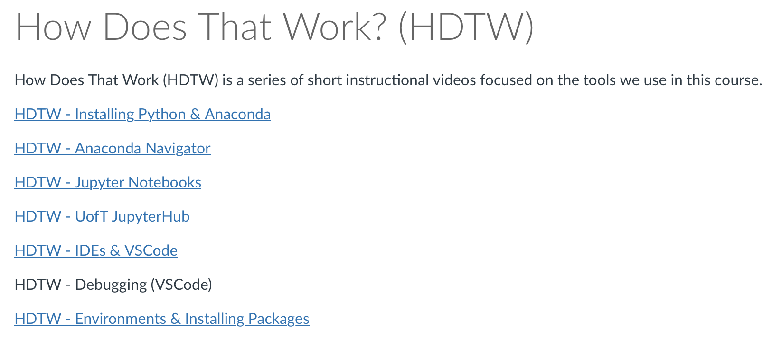
Feeling Confused?
Modules -> Course Resources -> How Does That Work?

Slide 11
Using an Integrated Development Environment (IDE)
IDEs are programs that provides tools and features to programmers in a unified environment
IDEs often include:
A code editor
A place to type and edit code, usually with colour-coded syntax highlighting to improve readability
Code compilers or interpreters
Turns the readable Python code into something the machine can understand
Debuggers
Pause the code at pre-determined locations and go line-by-line through your code
Version Control (i.e., git)
Code navigation tools
A Built-in terminal
Integrated documentation (access to help resources from within the IDE)

Slide 12
Which should IDE to use?
IDLE is the official IDE included with Python that provides a basic environment for editing and running programs
Other popular IDEs differ in features and supported programming languages
Popular IDEs include:
Visual Studio / VS Code (Microsoft)
Xcode (Apple)
Android Studio (Google)
PyCharm
Jupyter (web-based)
NetBeans
Eclipse
This course will both VSCode and Jupyter.
Jupyter will be used in lectures, and VSCode is the supported IDE in later labs.
To write a document, you use a “Word Processor” such as Microsoft Word, Google Docs, or Apple Pages
Similarly, to write a software program, you use an IDE such as IDLE, PyCharm, or Jupyter
Notes:
Anaconda comes with some built-in, Spyder, VS Code, PyCharm - recommiending PyCharm
Poycharm Professional VS Community

Slide 13

PyCharm Community vs. Professional
Community
Free
Popular IDE with common features
Can run and edit Python files (.py)
Professional
Paid
Free with JetBrains education license (must complete an application with U of T email)
Can also run and edit Jupyter Notebooks (.ipynb)
PyCharm Community is good enough for APS106!
You may use other IDEs if you are comfortable
PyCharm is the supported IDE in labs

Slide 14
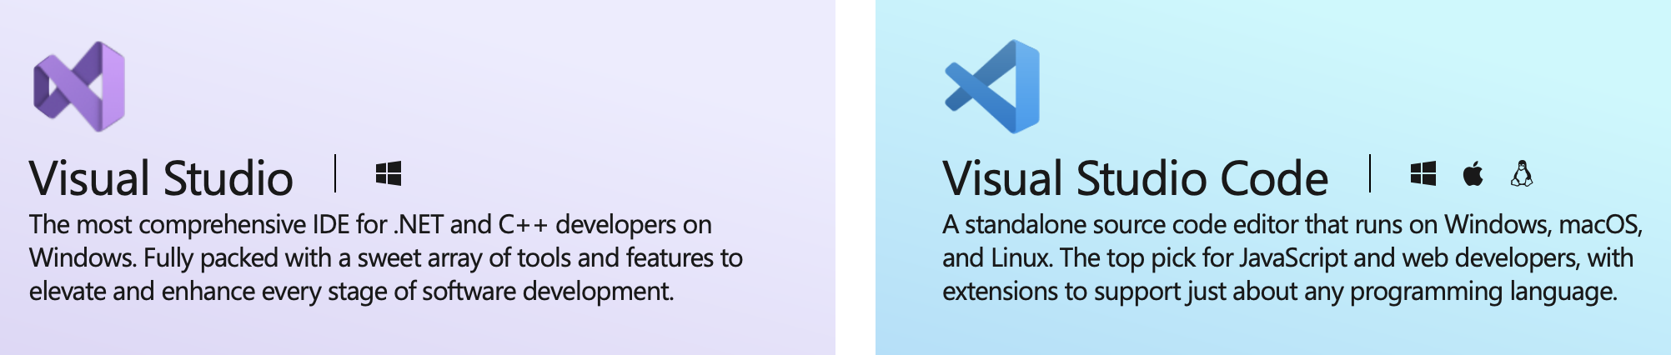
Friendly Warning: Visual Studio (VS) Code ≠ Visual Studio
Windows, Mac, Linux
Faster for laptops & older computers
Simple interface, quick to set up
Flexible extensions as required
Primarily Windows
For large enterprise projects
Requires more system resources
Complex interface for experts
VSCode is good enough (and recommended) for APS106!
You may use other IDEs if you are comfortable
VSCode is the supported IDE in labs

Slide 15
A Quick Note on File Formats and Extensions
Files store data in different formats based on specific definitions
An “extension” is the file name’s suffix, or the set of characters (usually 2-4) at the end of a file name, separated by a period (.)
File Types | Common Extension Examples
Plain text file | .txt
Word processor files | .doc, .docx, .pdf
Image files | .jpg, .gif, .png
Compressed/Archive files | .zip, .rar, .7z
Video files | .mpg, .mp4, .avi
Executable files | .exe, .bat, .bin
Python file | .py
Jupyter Notebook file | .ipynb
Comma Separated Value file | .csv
File extensions help indicate:
The file format
How the data is structured
Which programs can open it

Slide 16

Anaconda Navigator
Anaconda is a distribution of Python that includes tools and packages geared towards scientific computing (such as data science and machine learning)
Anaconda Navigator is the graphical user interface (GUI) allowing users to install and manage their programming environment without command line (terminal) prompts

Slide 17
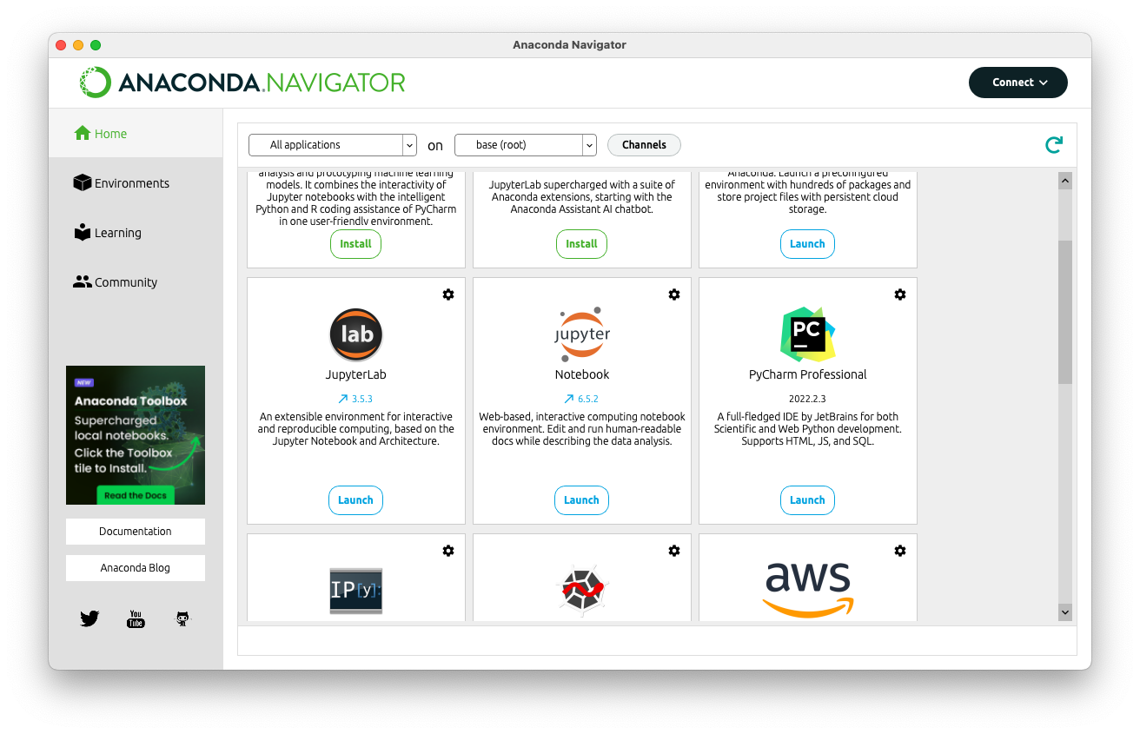
Anaconda Navigator
Your first core use of Navigator is to open Jupyter Notebook (not JupyterLab)
More advanced (optional):
In the Environments tab on the left you can manage the packages installed for different “environments”
Installing a specific version or package for one project shouldn’t necessarily affect all projects
”Environments” allow developers to isolate project workspaces (with specific Python versions and installed packages

Slide 18


What is Jupyter?
Jupyter Notebook
Interactive and web-based environment
Creates ”notebooks” (.ipynb files) that can combine live code, visualisations, and narrative text
Code can be divided into individually-executable “cells”
Cells can include either executable code, or formatted text and images
Can export notebooks to HTML or PDF
JupyterHub
A cloud-based server for running Jupyter notebooks
Does NOT run locally on your computer (think: Microsoft Word vs the cloud-based Google Docs)
Allows you to ”clone” lecture notebooks and work on notebooks in the cloud
A good solution if your local Jupyter environment suddenly stops working in lecture
Notes:
Moving on from PyCharm to Jupyter

Slide 19
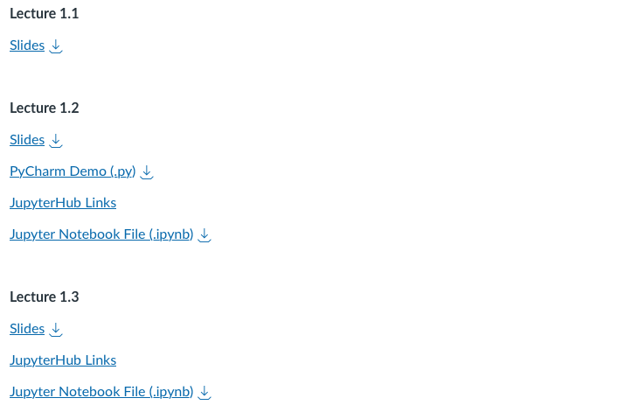
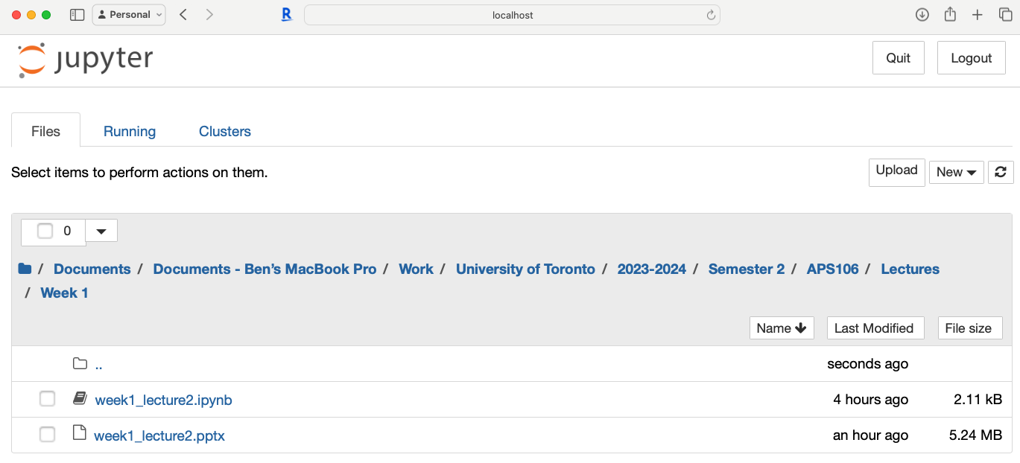
Opening Your First Notebook (.ipynb) File
Download the Notebook (.ipynb) file from Quercus
Open Jupyter Notebook through Anaconda Navigator
Jupyter Notebook will open in your web browser, and you will see the directory (folder) system for your computer
Navigate to the folder where you downloaded the Notebook file (such as “Downloads” or your APS106 folder) and open the .ipynb file
Notes:
If you can’t get this working RIGHT NOW, don’t stress, use the jupyter hub link today and follow along.

Slide 20
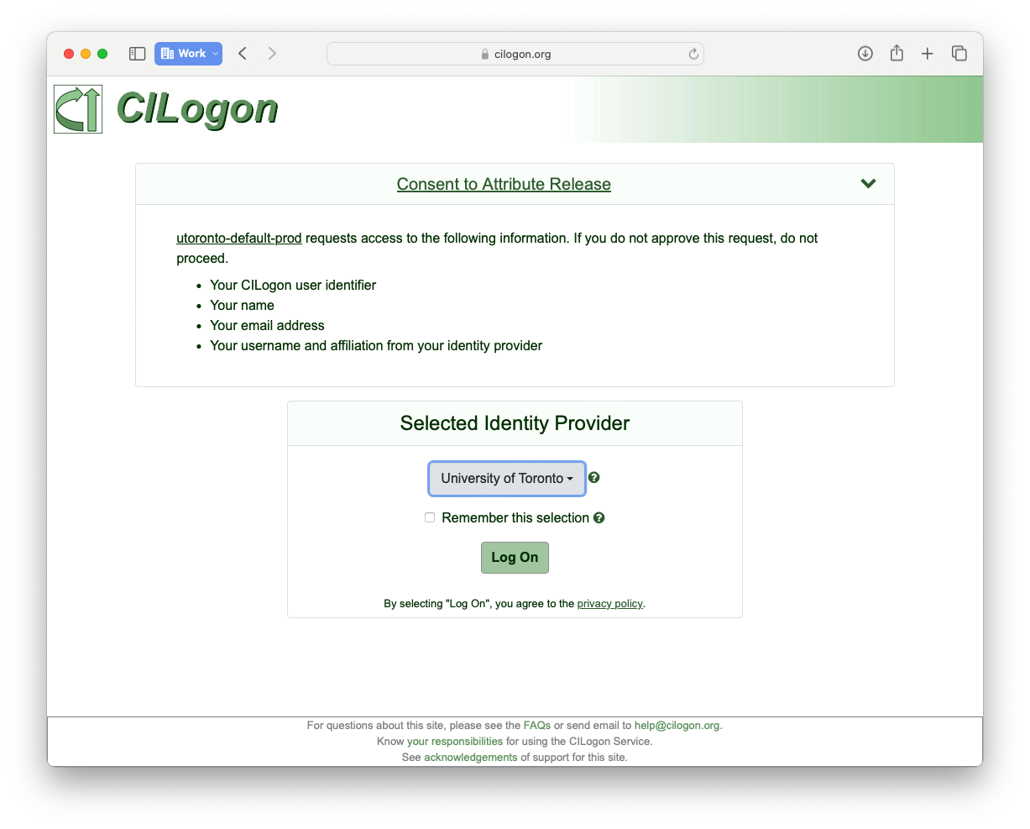
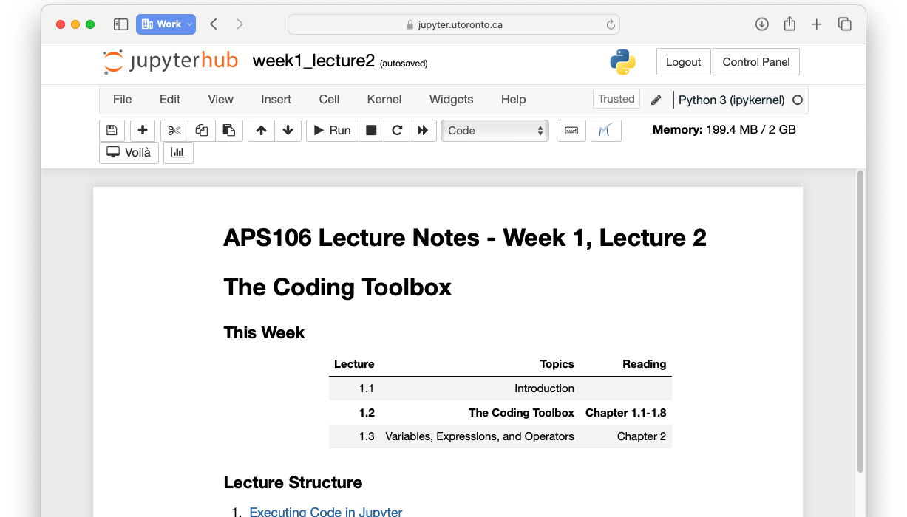
Opening From JupyterHub
Follow Quercus to this lecture’s JupyterHub link (Week 1, Lecture 2)
The first time using JupyterHub, you may see a “CILogon” screen
This is normal, continue logging in with your U of T account
Today’s lecture Notebook should open

Slide 21
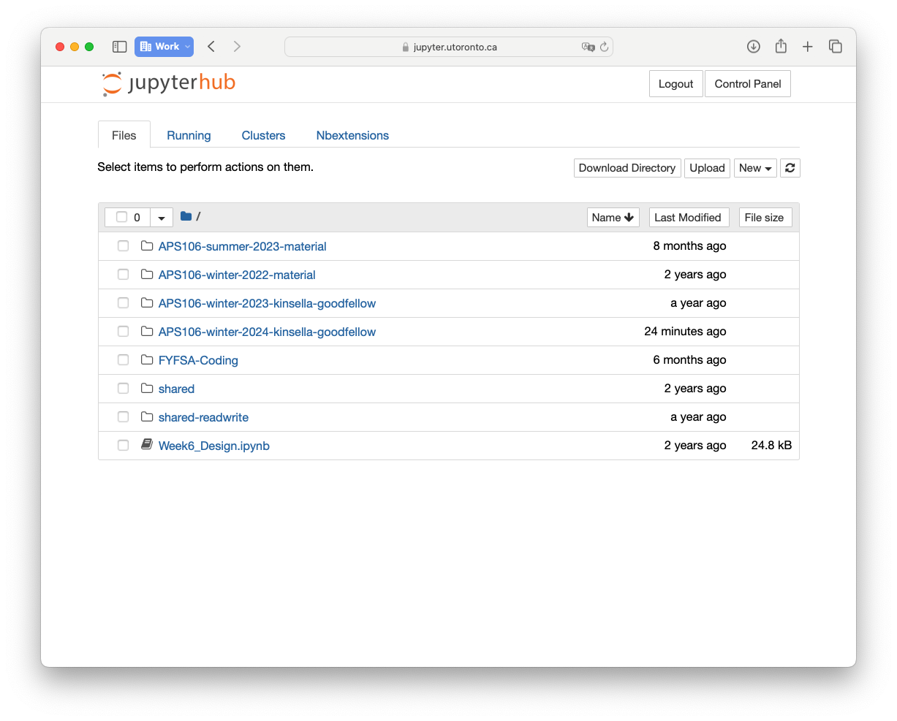
Navigating to your JupyterHub files
By clicking the link on Quercus, you have “cloned” (or copied) the lecture slides into your JupyterHub account
You can click the JupyterHub logo on the top left to open the directory to your JupyterHub account and access any other lectures you have previously cloned
It is always safer to store files on your computer’s local storage (i.e., not on JupyterHub)!

Slide 22
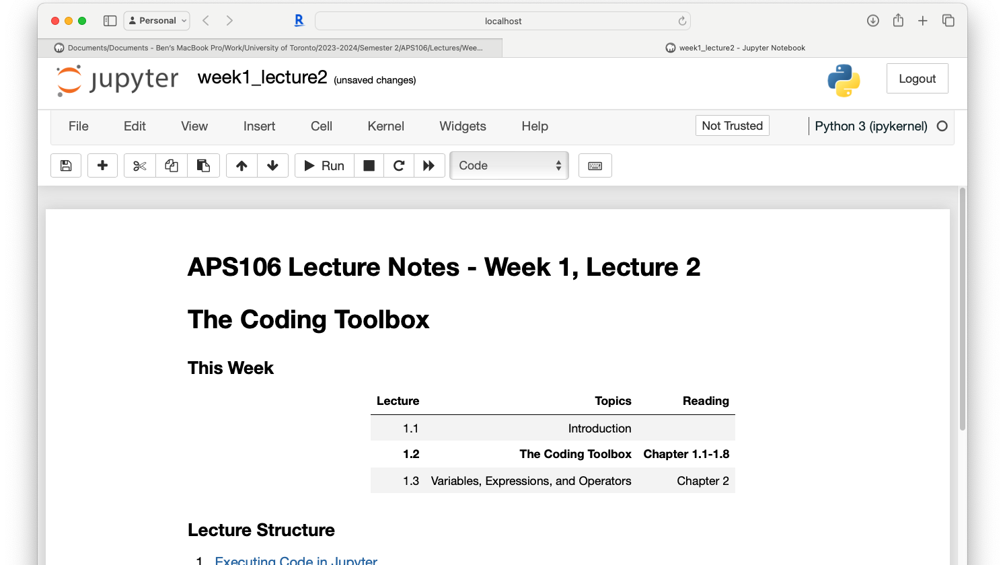
Jupyter vs. JupyterHub
Compare the difference in “URLs” on your computer
You’ll see Jupyter points to a local file on your computer, whereas JupyterHub is on an external website

Slide 23
Let’s Quickly Explore Jupyter
Explore different cell types
Execute Python code in Jupyter
Other helpful Jupyter tips
You can use the downloaded .ipynb file or JupyterHub links to follow along
Open your notebook
Click Link:
1. Exploring Cell Types in Jupyter
Notes:
Our first breakout coding session that we’ll do together. We’re going to do this a few times today, so keep the notebook open, and get used to this, because we’re going to do it a lot this semester. We will usually have active breakout sessions in lecture, but for now it will be slightly more guided, so I can show you what Python coding looks like.

Slide 24
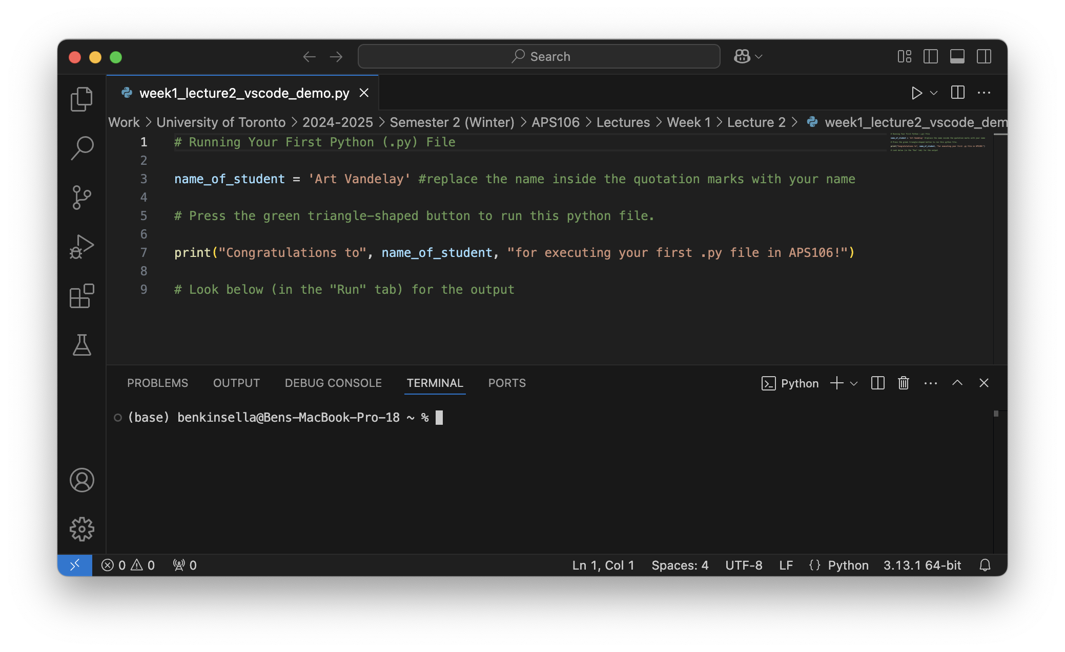
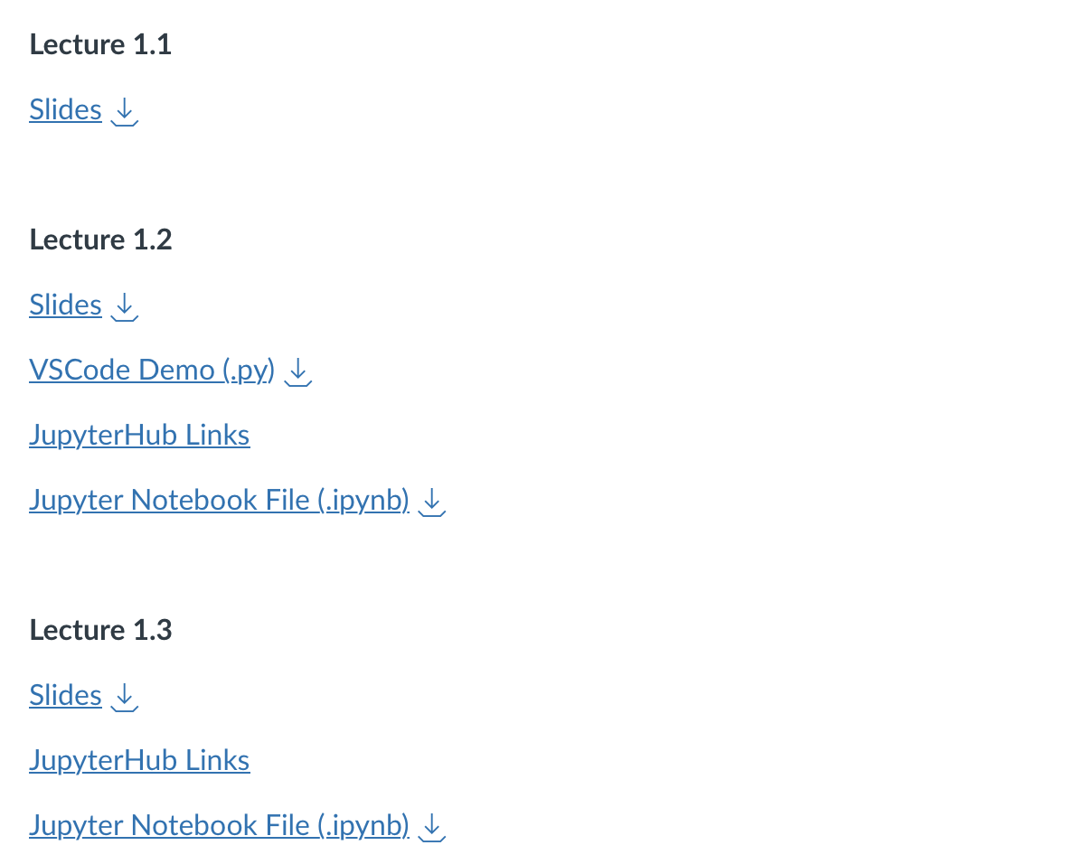
Running Your First Python (.py) File
Download this .py file from Quercus
Open VSCode on your Computer
In VSCode go to File -> Open -> find and open the .py file where you downloaded it

Slide 25
Click here to change the Python version and interpreter being used.
Click here to change the programming language. It should say Python for APS106.
Notes:
How to run and debug?
Historical figures, history of computer
Extensions, terminal, cPU, RAM, GPU, memory, transistors
Maybe visualise how all the departments disciplines are involved
Tools in course:
Environments

Slide 26
Take some time opening this on your personal computer
On Line 3, replace Art Vandelay with your name
Hit the triangle arrow to RUN or EXECUTE code
Notes:
How to run and debug?
Historical figures, history of computer
Extensions, terminal, cPU, RAM, GPU, memory, transistors
Maybe visualise how all the departments disciplines are involved
Tools in course:
Environments

Slide 27
What is Programming?
A way of telling a computer what to do.
A computer can’t infer (…yet).
Need to tell a computer every single step (or “instruction”) it needs to do in a language it can understand.
How would you request an egg for breakfast to a chef and to a computer/robot?
To a Chef
Sunny-side up, please!
To a Computer
“Turn on stove”
“Take out pan”
“Take one egg out of fridge”
“Crack egg”
“Pour egg into pan”
“Wait 5 minutes”

Slide 28


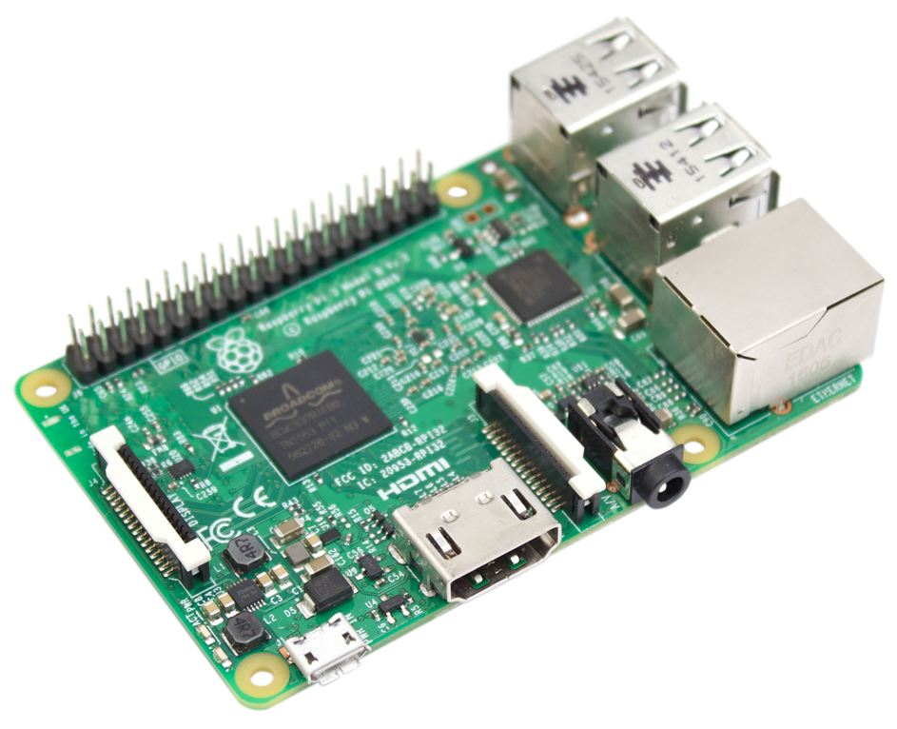
Programmer
English
How to Program a Computer.
Pseudocode
Programing Language
Compiler
Assembly Code
Assembler
Machine Code
Hardware
Notes:
We’ll talk a little bit more about assembly code vs machine code next lexture, but it’s really not important for the sake of this course.
There’s a reason we are teaching in Python

Slide 29
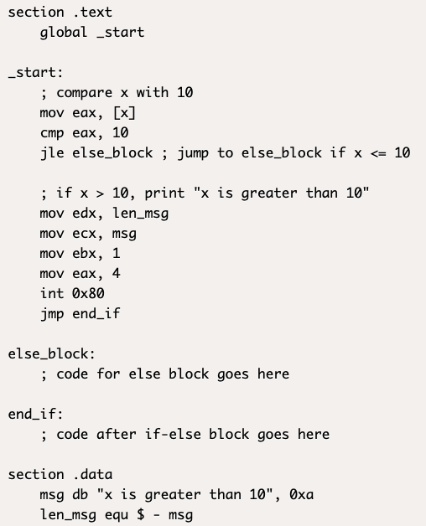
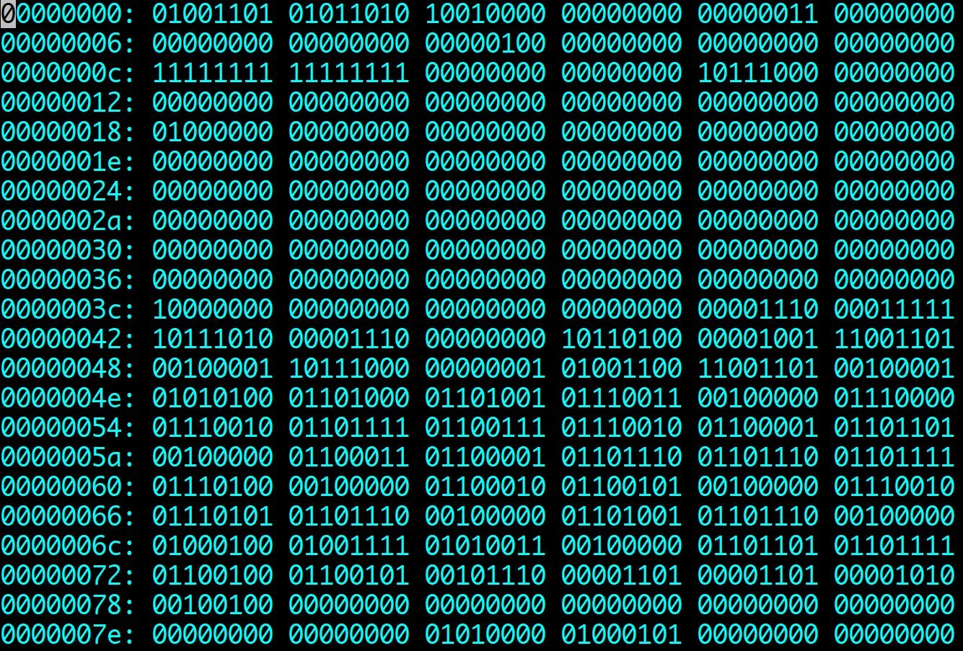
The power of programming languages
if x > 10:
print(”x is greater than 10”)
Notes:
Assembly code on the left, you definitely don’t need to know what that does, but you can see based on the comments on the right, that there’s only 1 very simple step per line. Whether that’s read, store I, read, store J, load I, load J, compare, all of these steps could have been done in a line or two of python code. And then you’ll see how it converts to machine code. The most basic form of code that the hardware on your computer is using, just 0s and 1s. You don’t necessarily need to know this, but does anyone know what the 0s and 1s represent?
Basic code for off and on, switches in the electrical hardware, turning on and off, depending on the 0 or 1, that creates the electrical signal to produce the output you want. But this may as well look like the matrix code for a lot of us. This is why we use a programming language like Python. We can take something in code we can easily write and understand, and turn that into a series of electrical signals that our computer produces to create an output we want.

Slide 30
Packaging instructions for our computer
(1) Python converts to machine code
Python takes human-readable instructions and converts this to machine code (binary: 1s and 0s)
(2) Machine code determines transistor voltages
This sequence of 1s and 0s determines which transistors in the CPU are ON and OFF, representing one specific instruction for the machine
(3) Instructions given sequentially on each clock cycle
Each instruction is given in sequence and executed according to the processors clock speed (number of instructions per second)
Most of this is outside the scope of APS106.
If we can provide the correct Python instructions in Step (1), the computer will do what we tell it to!
Next class we will learn how to assign variables to memory and begin using programming as a tool to solve problems!
Notes:
Coming full circle back to our initial discussion about parts of a computer and CPU
These transistors are made from rare silicon, are we are fully dependent on our mining engineers to extract and purify silicon.

Slide 31
The Coding Toolbox.
Week 1 | Lecture 2 (1.2)
Upcoming:
Lab 0 released Thursday at 6 PM
Reflection 1 released Friday at 6 PM
First PRA section – Friday 3-5 PM
Notes:
Historical figures, history of computer
Extensions, terminal, cPU, RAM, GPU, memory, transistors
Maybe visualise how all the departments disciplines are involved
Tools in course:
Anaconda
Jupyter
Environments
Shortcuts on Jupyter (shift enter) markdown etc.
Cells are linked, variables common across cells
Update cells down doesn’t update cells above
Kernel restarting
Clear output and variables

Slide 32
Everything after this point is could be incorporated into Week 1 Lecture 3 (or at least some variation of it)
Some of this has lost its home from last year (with no “Programming Process” lecture) but is still probably important to discuss early, such as code readability, commenting, and testing.
The integral example is new this year and I will experiment with this to try a new way to teach the value of meaningful names and comments

Slide 33
Introducing Python
No end-of-instruction separators, such as semicolons (like in C or Java)
Python programs are stored in .py files
Comments start with a # character
Whitespace matters (exactly 4 spaces means indentation)
Python is an interpreted language (not a compiled one)
You can run code one statement at a time, just like a calculator or Matlab
This means variables can change type during runtime, and do not have to be declared before running

Slide 34
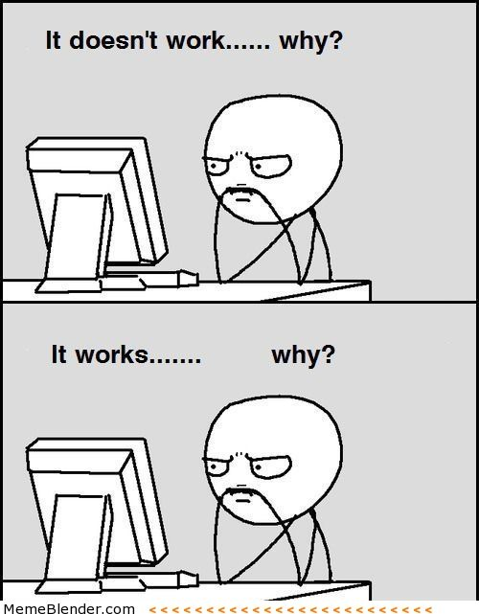
Programming Guide 101
Readability
If nothing else, write #cleancode
Comments
Save yourself from yourself
Lots of testing!
Modular code (you will learn about functions next week)
Test often and with purpose
Understanding errors
Reading and interpreting error codes
Always have a plan!

Slide 35

Readability Tips (#cleancode)
>>> canda = cat + panda
Use whitespace to separate variables and operators
>>> canda=cat+panda
Be consistent with spacing, too much whitespace can be bad
>>> canda = cat +panda
Pick variable names that are easy to read and interpret
>>> canda = nom + nomnomnomnomnom
Be consistent with naming schemes
>>> Canda = CAT + _panda42

Slide 36
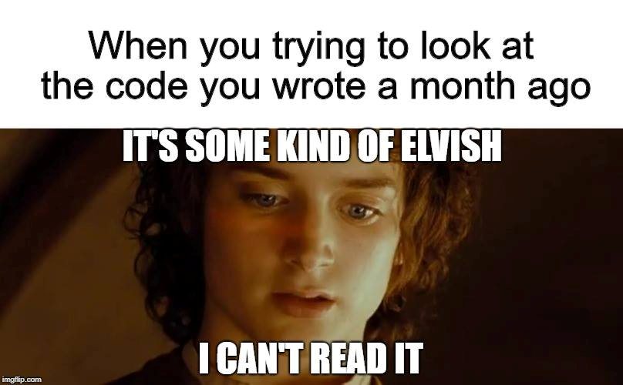
Comments
Comments are to help you, and anyone else who is reading/using your code, to remember or understand the purpose of a given variable or function in a program.
A comment begins with the number sign (#) and goes until the end of the line.
Python ignores any lines that start with the (#) character

Slide 37
What does this piece of code do?
def my_function(x, y, z, zz=1000):
k = (z - y) / x
t = 0.5 * (x(y) + x(z))
for i in range(1, zz):
x_i = y + i * k
t += x(x_i)
result = h * t
return result

Slide 38
What about now?
def my_function(f, a, b, n=1000):
h = (b - a) / n
sum = 0.5 * (f(a) + f(b))
for i in range(1, n):
x_i = a + i * h
sum += f(x_i)
result = h * sum
return result

Slide 39
What about now?
def my_function(f, a, b, n=1000):
h = (b - a) / n # Width of each trapezoid
integral_sum = 0.5 * (f(a) + f(b)) # Sum the endpoints
for i in range(1, n):
x_i = a + i * h
integral_sum += f(x_i)
result = h * integral_sum
return result

Slide 40
Use meaningful comments and variable names
def calculate_integral(f, a, b, n=1000):
"""
Calculate the definite integral of a function using the trapezoidal rule.
Parameters:
f (function): The function to integrate.
a (float): The lower limit of integration.
b (float): The upper limit of integration.
n (int, optional): The number of trapezoids for numerical integration. Defaults to 1000.
Returns:
float: The approximate definite integral of the function over the specified range.
"""
h = (b - a) / n # Width of each trapezoid
integral_sum = 0.5 * (f(a) + f(b)) # Sum the endpoints
for i in range(1, n):
x_i = a + i * h
integral_sum += f(x_i)
result = h * integral_sum
return result

Slide 41
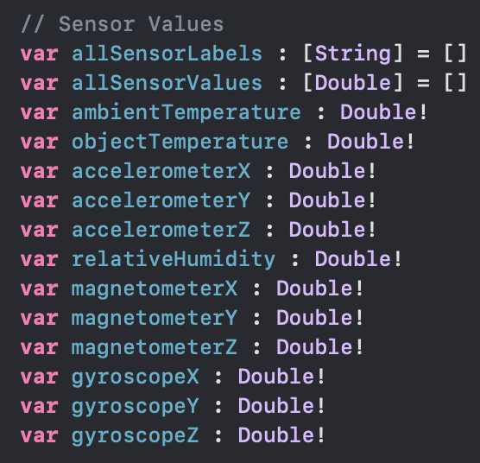
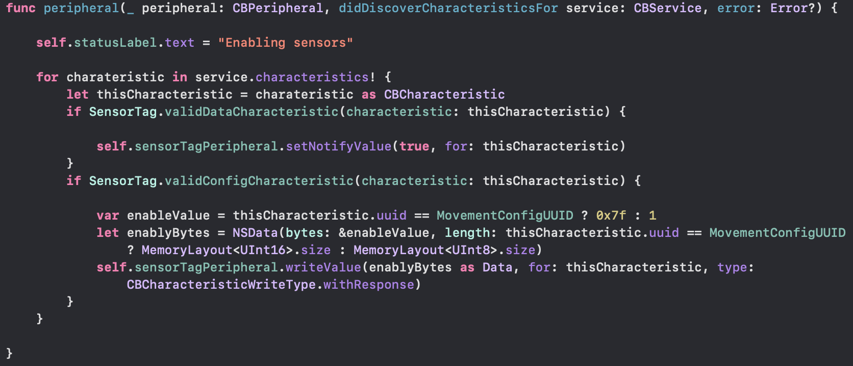
Warning! This is not Python! It is an example from one of my iOS apps I had to come back to after a few years. Meaningful variable names on the left saved me, but the lack of comments on the right was a nightmare. (Comments are (//) in Swift instead of (#) in Python)

Slide 42
Testing!
The more lines of code you write, the more likely it is that you will make a mistake and the harder it will be to find the mistake
“like finding a needle in a haystack”
Test your code as you write it
Requires you understanding what specific output an input will provide
”Modular code”
Test in small chunks or “modules”
Put a test input into the beginning where you know what the output is and see what you get!
Golden Rule: Never spend more than 15 minutes programming without testing

